Slide 1
(Almost) All of Machine Learning
Applied Data Analytics for Public Policy
Rayid Ghani
Slides liberally borrowed and customized from lots of excellent online sources

Slide 2
What we’ll cover today
What is Machine Learning?
Examples in the real world
How to solve problems using ML?
How to evaluate methods?
Methods
Doing ML with Python and sklearn

Slide 3
After today, you should be able to
Formulate a policy or social science problem as a machine learning problem
Understand, use, and evaluate machine learning methods

Slide 4
Machine Learning
“A computer program is said to learn from experience E with respect to some task T and some performance measure P, if its performance on T, as measured by P, improves with experience E.”

Slide 5
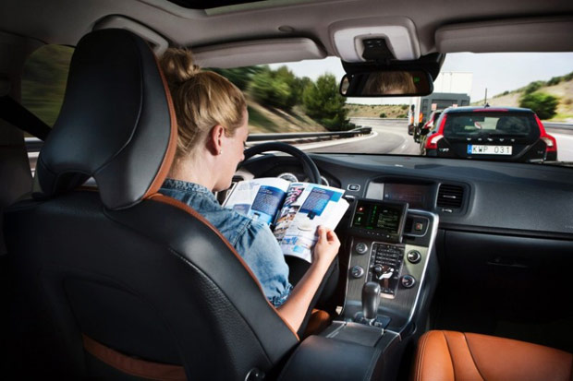
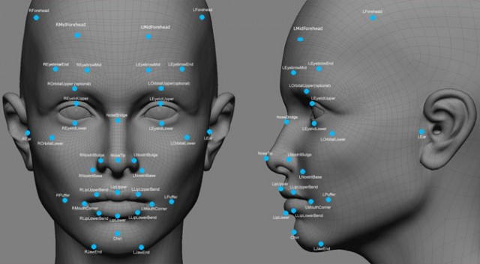


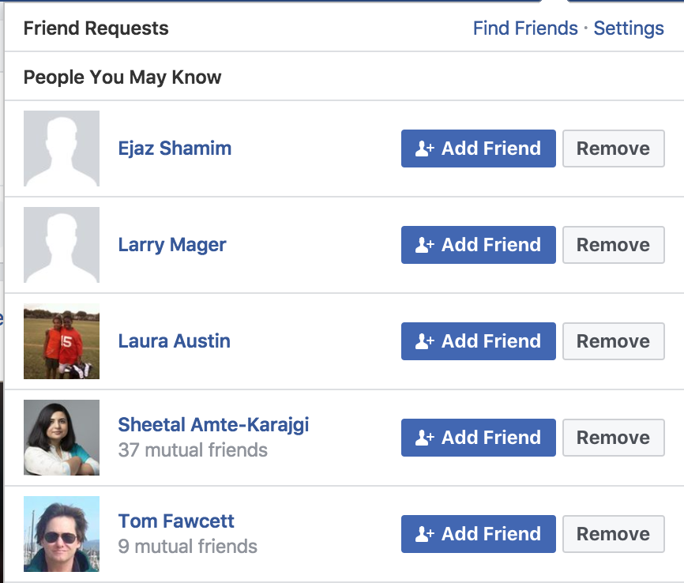
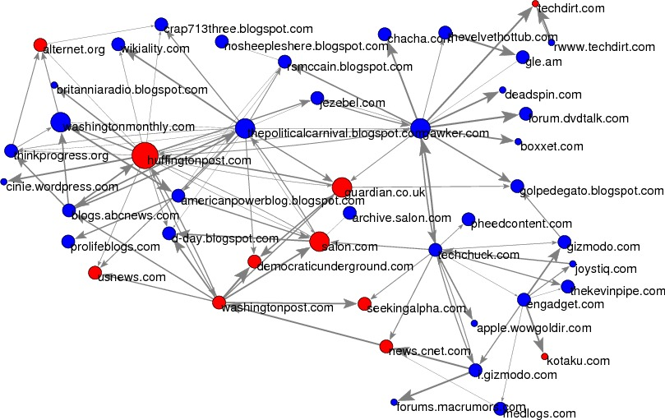
Notes:
Usps
Amazon/netflix - recommender
Advertising
Health
Autonomous cars

Slide 6
Why Machine Learning?
Goal: Adaptive, Scalable systems that are cost effective to build and maintain
Rules-based systems are rigid and expensive
Lots of data is available to “train” the system
People are better at “training” the system compared to “building” the system

Slide 7
Process
Understand “Business” problem
Map to Machine Learning problem
Get (and integrate) the data
Explore and Process the data
Create “Features”
Select which methods to test
Evaluate methods
Deploy, Maintain, Update

Slide 8
Types of ML tasks for Policy Problems
Description (Understand the past)
Detection (Anomalies, Events, Patterns)
Prediction (Predict the Future)
Behavior Change (Causal Inference)

Slide 9
Types of Learning
Unsupervised
Clustering
PCA
…
Supervised
Classification
Regression
…

Slide 10
Unsupervised Learning
No outcome or dependent variable is present
Goal is exploration, understanding historical data, finding patterns and/or groups in the data
Examples
Clustering (cluster analysis)
Principal Components Analysis
Association Rules (beer and diapers)

Slide 11
Clustering
A good clustering method will produce clusters with
High intra-cluster similarity
Low inter-cluster similarity
K-Means is the simplest and the most common algorithm

Slide 12
K-means example, step 1
k₁
Y
Pick 3
initial
cluster
centers
(randomly)
k₂
k₃
X

Slide 13
K-means example, step 2
k₁
Y
k₂
Assign
each point
to the closest
cluster
center
k₃
X

Slide 14
K-means example, step 3
k₁
k₁
Y
Move
each cluster center
to the mean
of each cluster
k₂
k₃
k₂
k₃
X

Slide 15
K-means example, step 4
Reassign
points
closest to a different new cluster center
k₁
Y
k₃
k₂
X

Slide 16
K-means example, step 4 …
k₁
Y
Reassigned Data points
k₃
k₂
X

Slide 17
K-means example, step 4b
k₁
Y
re-compute cluster means
k₃
k₂
X

Slide 18
K-means example, step 5
k₁
Y
k₂
move cluster centers to cluster means
k₃
X

Slide 19
K-means algorithm
Given k, the k-means algorithm works as follows:
Randomly choose k data points (seeds) to be the initial centroids, cluster centers
Assign each data point to the closest centroid
Re-compute the centroids using the current cluster memberships.
If a convergence criterion is not met, go to 2).

Slide 20
More Clustering Methods
K-means
Iteratively re-assign points to the nearest cluster center
Agglomerative clustering
Start with each point as its own cluster and iteratively merge the closest clusters
Mean-shift clustering
Estimate modes of pdf
Spectral clustering
Split the nodes in a graph based on assigned links with similarity weights
As we go down this chart, the clustering strategies have more tendency to transitively group points even if they are not nearby in feature space

Slide 21
Evaluating Clustering Methods
Objective Evaluation
Task-Specific Evaluation
Same data can be clustered in different ways in different number of clusters
Can be used to interactively explore data

Slide 22
Supervised learning framework
y
= f( )
X
output
“Learned”
function
Features/Predictors
future/generalization
Training or Learning: Find an f that minimizes error in recovering y
Slide credit: L. Lazebnik

Slide 23
Supervised learning framework
y
= f( )
X
output
“Learned”
function
Features/Predictors
Training: Given a training set of labeled examples {(x₁,y₁), …, (x_{N},y_{N})}, estimate the prediction function f that minimizes future generalization (out of sample) error
Scoring/Testing: apply f to a new example x and output the predicted value y = f(x)
Slide credit: L. Lazebnik

Slide 24
Steps
Data Preparation
Build Model
Validate Model
Deploy Model
Features

Slide 25
How to solve a prediction problem
Define and Create label (outcome variable)
Define and Create Features (predictors)
Create Training and Validation Sets
Train model(s) on Training Set
Validate model(s) on Validation Set

Slide 26
Validation
You’ve run a large number of different types of models
You need to understand what types of models work when, and
You need to decide which one(s) to use in the future

Slide 27
What we need to validate
Methodology
Metric(s)
Comparing to baselines

Slide 28
In-sample
Data
Train
Test

Slide 29
Out-of-Sample
Data
Train
Test

Slide 30
N-fold Cross-Validation
Data
1
2
3
4
5
Train
Test

Slide 31
N-fold Cross-Validation
Data
1
2
3
4
5
Train
Test

Slide 32
N-fold Cross-Validation
Data
1
2
3
4
5
Train
Test

Slide 33
N-fold Cross-Validation
Data
1
2
3
4
5
Train
Test

Slide 34
N-fold Cross-Validation
Data
1
2
3
4
5
Train
Test

Slide 35
Temporal Holdouts
Data
2002 2017
Train
Test
2002 2007 2008
Train
Test
2002 2008 2009
Train
Test
2002 2009 2010

Slide 36
Evaluation - Methodology
In-sample
Out of sample
Multiple Out-of-sample (Hold-out) Splits
Cross Validation
Leave one out (LOO)
K fold
Temporal Holdouts

Slide 37
Modeling & Validation
Training (Building)
Training Labels
Features
Training
Learned model
Training Data
Testing (Validating)
Features
Learned model
Prediction
Test Data

Slide 38
Evaluation - Metrics
Predictions are often scores between 0 and 1
We need to first turn them into 0 or 1 by selecting a threshold
Predicted Class
 | Yes | No
Yes | True Positives (TP) | False Negatives (FN)
No | False Positives (FP) | True Negatives (TN)
Actual Class

Slide 39
Evaluation – Metrics (at a threshold k)
Accuracy = (TP + TN) / (TP + TN + FP + FN)
Precision (or PPV) = TP / (TP + FP)
Recall (or Sensitivity) = TP / (TP + FN)
Specificity = TNR
Predicted
 | Yes | No
Yes | True Positives (TP) | False Negatives (FN)
No | False Positives (FP) | True Negatives (TN)
Actual

Slide 40
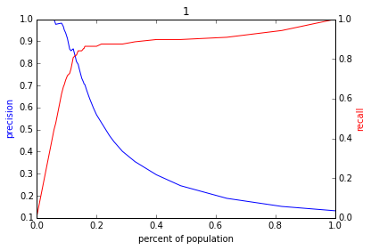
Varying the Threshold

Slide 41
ROC Curve
Receiver Operator Characteristic Curve

Slide 42
AUC

Slide 43
Evaluation - Baselines
Random (predict most frequent class)
Simple heuristics
Expert heuristics

Slide 44
Supervised Learning - Methods
Overfitting vs Underfitting

Slide 45
(Some) Popular/Common Methods
Nearest neighbor
Decision Trees
Regression
Support Vector Machines
Bayes Classifier (not going to cover)
Neural Networks (not going to cover)
Ensembles
Bagging
Boosting
Random Forests

Slide 46
Classifiers: Nearest neighbor
Test example
Training examples from class 2
Training examples from class 1
f(x) = label of the training example nearest to x
All we need is a distance function for our inputs
No training required!
Slide credit: L. Lazebnik

Slide 47
K-nearest neighbor
x
x
x
o
x
x
x
+
o
o
x
x
o
o
+
o
o
x2
x1

Slide 48
1-nearest neighbor
x
x
x
o
x
x
x
+
o
o
x
x
o
o
+
o
o
x2
x1

Slide 49
3-nearest neighbor
x
x
x
o
x
x
x
+
o
o
x
x
o
o
+
o
o
x2
x1

Slide 50
5-nearest neighbor
x
x
x
o
x
x
x
+
o
o
x
x
o
o
+
o
o
x2
x1

Slide 51
Using K-NN
Simple
“Cheap” to train – just involves storing data
Scoring new data can be slow (needs to compute distances)

Slide 52
Classifiers: Decision Trees
# of Previous Entries in Prison
Average length of stay in Prison
Class: Negative prob = 2/100
Class: Positive prob = 32/50
Average length of stay in Prison
Class: Negative prob = 18/60
Class: Positive prob = 84/120
<=2
>2
<=90 days
>90 days
< 30 days
>= 30 days

Slide 53
What do we need to build a tree?
How to create a split?
When to stop?

Slide 54
How to create a split?
Which of the many features/predictors/variables do we choose to split?
What do we want the split to result in?
Purity of the leaf node
How do we measure purity?

Slide 55
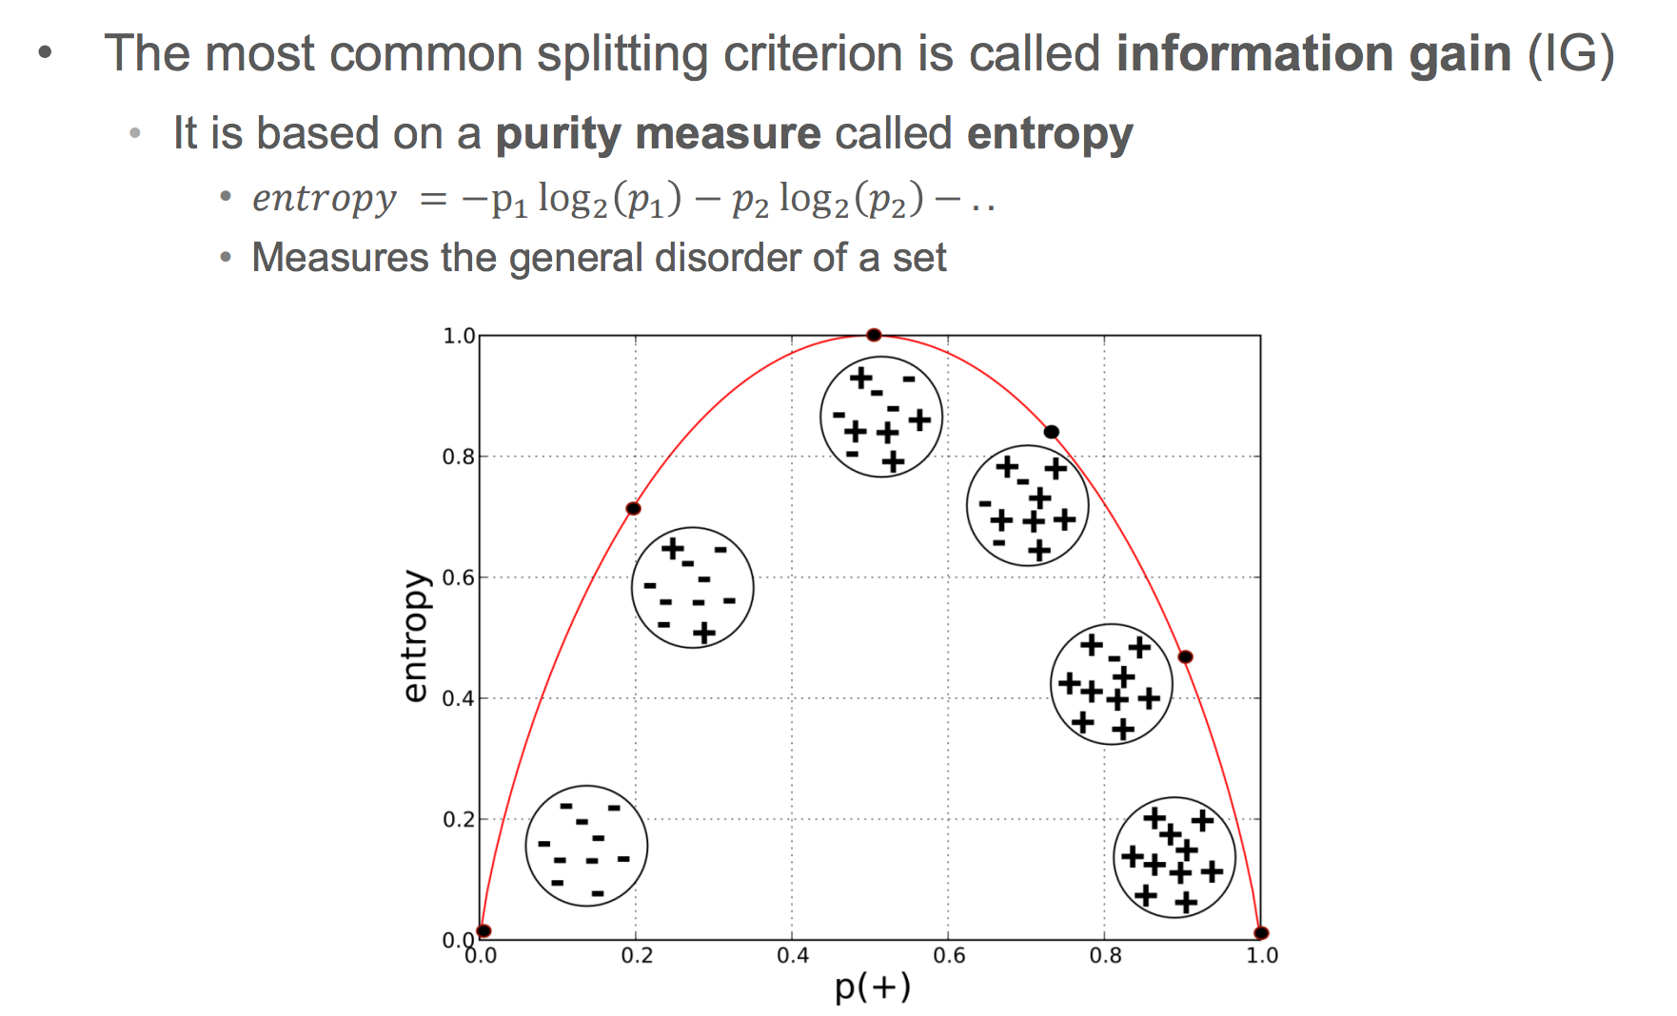
Information Gain

Slide 56
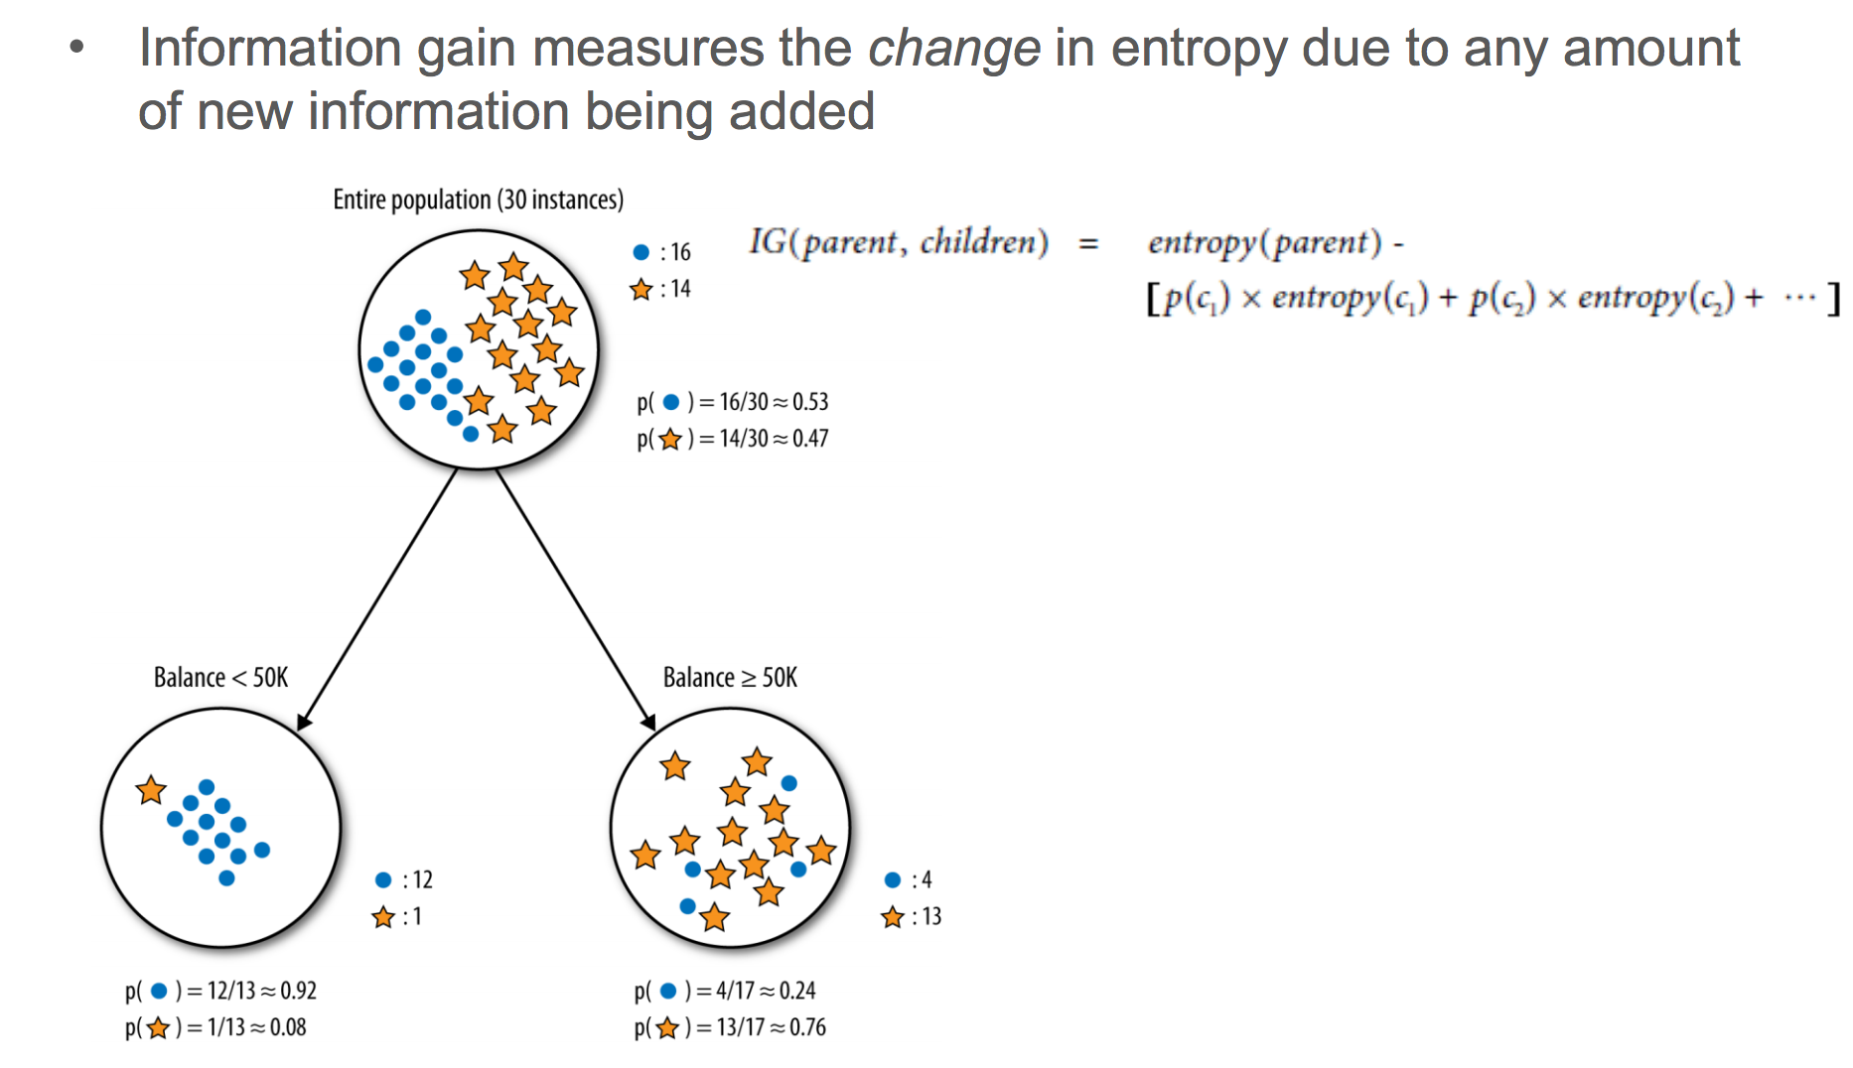

Slide 57
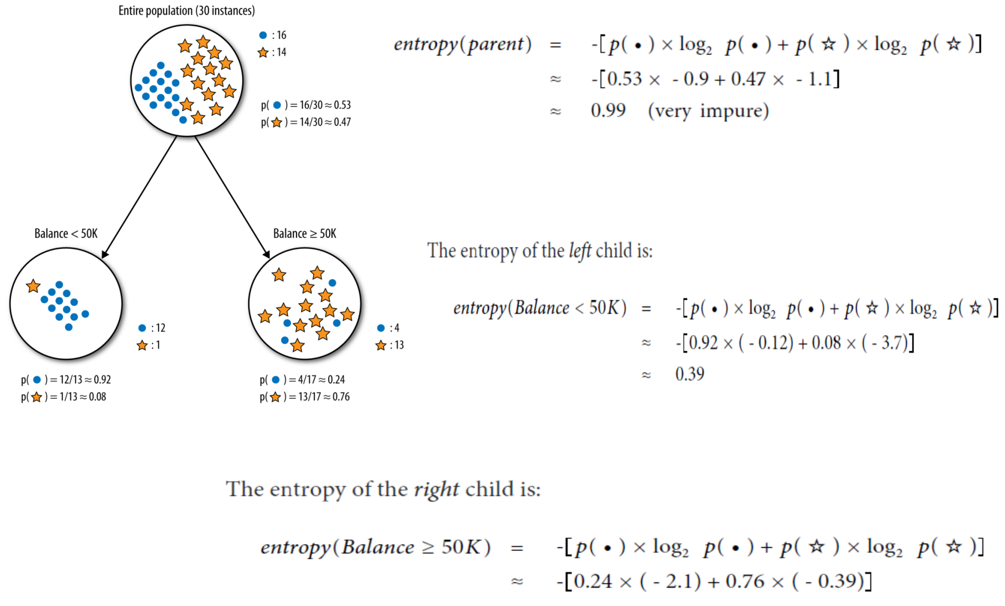

Slide 58
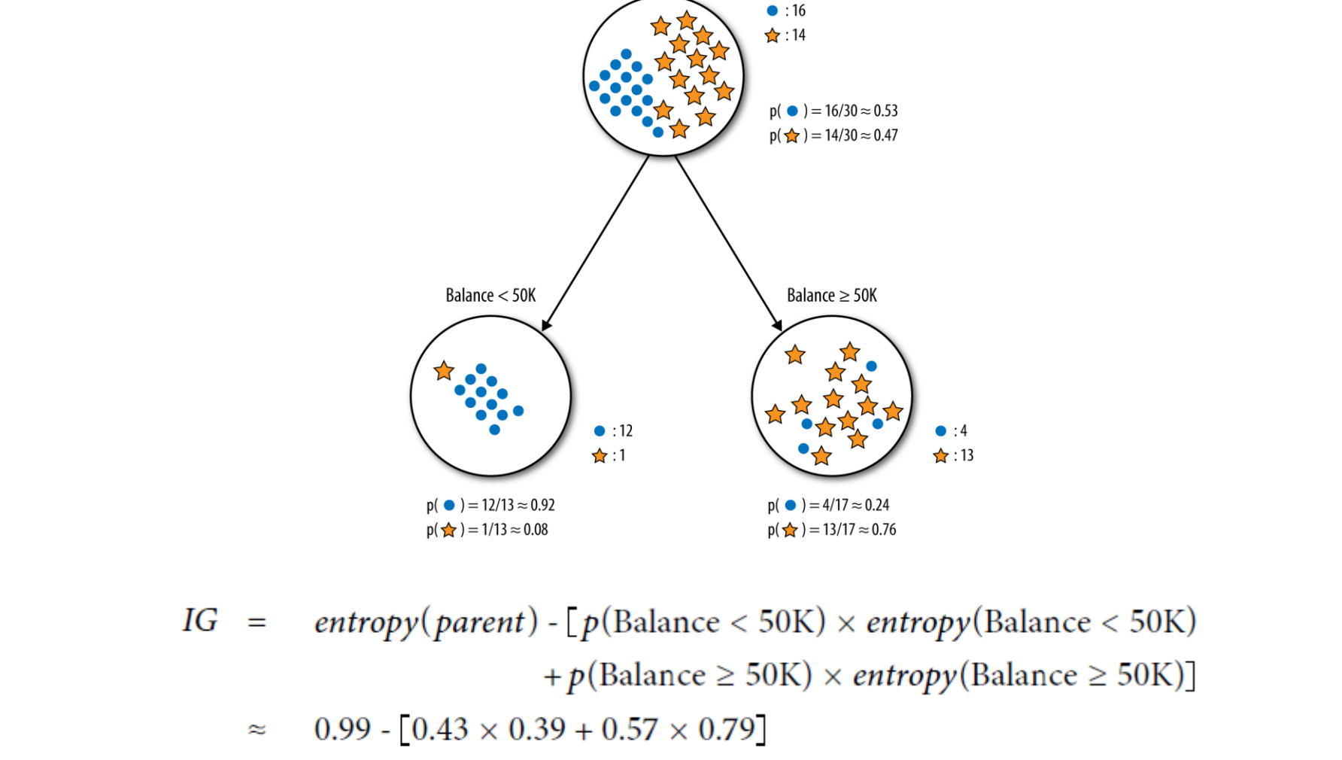

Slide 59
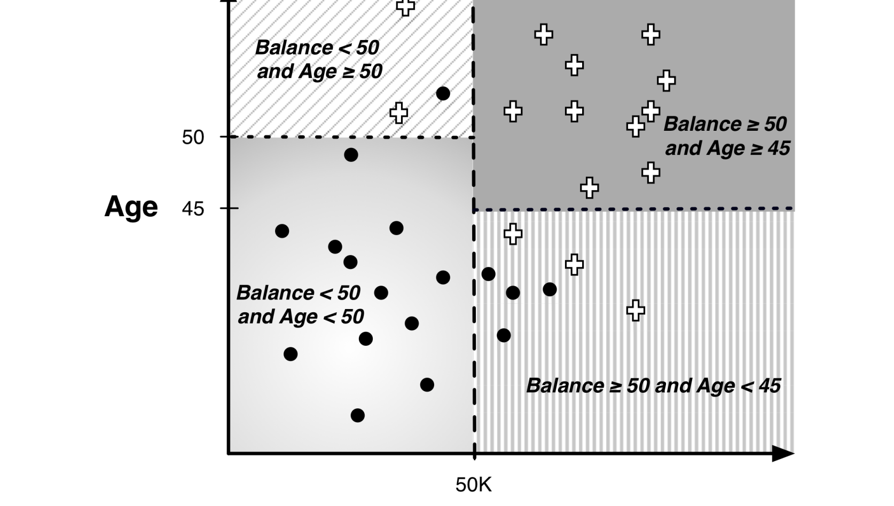
Another way of looking at Decision Trees

Slide 60
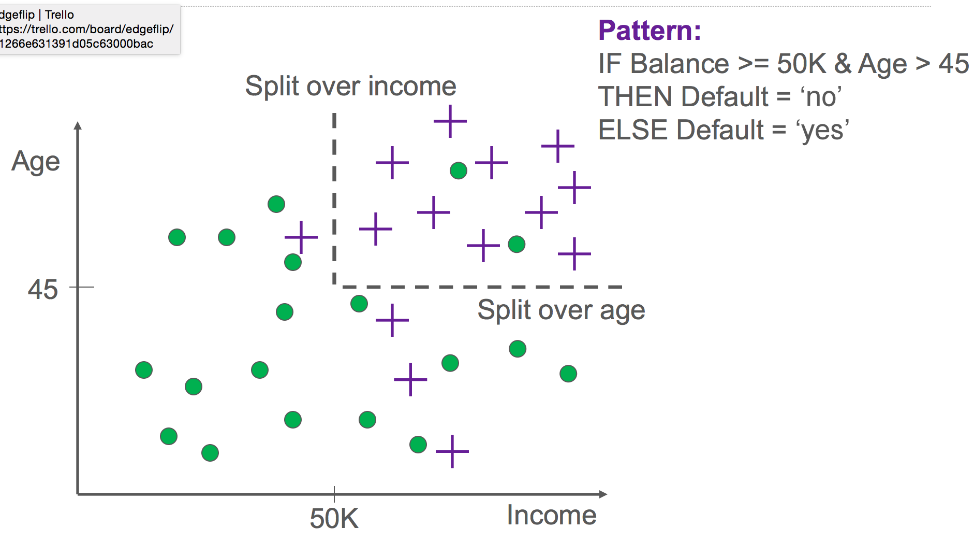

Slide 61
Decision Trees: Summary
Easy to build
Performance is ok
Sometimes easy to understand
Computationally Fast/Cheap

Slide 62
Naïve Bayes
y
x₁
x₂
x₃

Slide 63
Using Naïve Bayes
Simple thing to try for categorical data
Very fast to train/test

Slide 64
Classifiers: Logistic Regression
Maximize likelihood of label/outcome given data
x
x
x
x
x
x
Yes
o
x
x
o
o
o
No
o
x2
x1

Slide 65
Using Logistic Regression
Quick, simple classifier (try it first)
Outputs a “probability”
Use L2 or L1 regularization
L1 does feature selection and is robust to irrelevant features but slower to train

Slide 66
Classifiers: Linear
Find a linear function to separate the two classes
Slide credit: L. Lazebnik

Slide 67
Classifiers: Support Vector Machines
x
x
x
x
x
x
o
x
x
o
o
o
o
x2
x1
Find a linear function to separate the classes:
f(x) = sgn(w ⋅ x + b)

Slide 68
Classifiers: Linear SVM
Too many possible boundaries
SVMs attempt to maximize the “margin”
Optimization problem
x
x
x
x
x
x
o
x
x
o
o
o
o
x2
x1
Notes:
Maximizes a margin

Slide 69
Classifiers: Linear SVM
Allow errors to keep models simple

Slide 70
Nonlinear SVMs
Datasets that are linearly separable work out great:
But what if the dataset is just too hard?
We can map it to a higher-dimensional space:
0
x
0
x
x²
0
x
Slide credit: Andrew Moore

Slide 71
Nonlinear SVMs
General idea: the original input space can always be mapped to some higher-dimensional feature space where the training set is separable:
Φ: x → φ(x)

Slide 72
Nonlinear SVMs
The kernel trick: instead of explicitly computing the lifting transformation φ(x), define a kernel function K such that K(x_{i} , x_{j}) = φ(x_{i} ) · φ(x_{j})
(to be valid, the kernel function must satisfy Mercer’s condition)
This gives a nonlinear decision boundary in the original feature space:
C. Burges, A Tutorial on Support Vector Machines for Pattern Recognition, Data Mining and Knowledge Discovery, 1998

Slide 74
Ensemble Learning
Different methods
Algorithms with different choice for parameters
Data set with different features (e.g. random subspace)
Data set = different subsets (e.g. bagging, boosting)

Slide 75
Ensemble Methods
Bagging (Bootstrap Aggregation)
Boosting
Random Forests
Stacking

Slide 76
Ensemble Methods: Bagging
Create ensembles by repeatedly randomly resampling the training data (Brieman, 1996).
Given a training set of size n, create m samples of size n by drawing n examples from the original data, with replacement.
Each bootstrap sample will on average contain 63.2% of the unique training examples, the rest are replicates.
Combine the m resulting models using simple majority vote.

Slide 77
Ensemble Methods: Bagging
For i = 1 .. M
Draw samples with replacement
Learn classifier C_{i}
Final classifier is a vote of C₁ .. C_{M}
Increases classifier stability/reduces variance
figure from Friedman et al. 2000

Slide 78
Boosting
Examples are given weights.
At each iteration, a new hypothesis is learned and the examples are reweighted to focus the system on examples that the most recently learned classifier got wrong.

Slide 79
Boosting
General Loop:
Set all examples to have equal uniform weights.
For t from 1 to T do:
Learn a classifier, C_{t}, from the weighted examples
Increase the weights of examples C_{t} classifies incorrectly
Base (weak) learner must focus on correctly classifying the most highly weighted examples while strongly avoiding over-fitting.
During testing, each of the T hypotheses get a weighted vote proportional to their accuracy on the training data.

Slide 80
Ensemble Methods: Boosting
Improves classification accuracy
Can be used with many different types of classifiers
figure from Friedman et al. 2000

Slide 81
Random Forests
Motivation: reduce error correlation between classifiers
Main idea: build a larger number of un-pruned decision trees
Key: using a random selection of features to split on at each node

Slide 82
How Random Forests Work
Each tree is grown on a bootstrap sample of the training set of N cases.
A number m is specified much smaller than the total number of variables M (e.g. m = sqrt(M)).
At each node, m variables are selected at random out of the M.
The split used is the best split on these m variables.
Final classification is done by majority vote across trees.
Source: Brieman and Cutler
82

Slide 83
Advantages of random forest
Works well
More robust with respect to noise.
More efficient on large data - parallelizable
Provides an estimation of the importance of features in determining classification
More info at: http://www.stat-berkeley.edu/users/breiman/RandomForests/cc_home.htm

Slide 84
Factors to consider
Complexity
Overfitting
Robustness
Interpretability
Training Time
Test Time

Slide 85
What to remember about classifiers
Better to have smart features and simple classifiers than simple features and smart classifiers
Need more training data with increasingly powerful/complex classifiers
Slide credit: D. Hoiem

Slide 86
Other tools
Languages
Python, R, Matlab (not open source)
Software Packages
Knime, Rapidminer, Weka (mostly research use)
Cloud
Amazon, Google, Microsoft
Commercial
SAS enterprise miner,Ibm/spss , Skytree, GraphLab, H2O

Slide 87
Things to be careful about
Bias
Explanations
Predictions may not be causal
Scores may not be probabilities

Slide 88
Reference Books & Articles
Machine Learning by Peter Flach
Good introduction to algorithms/models/methods
Data Science for Business by Provost and Fawcett
Good introduction to the ML process
Big Data: New Tricks for Econometrics by Hal Varian

Slide 89
Online Resources
Introduction to Statistical Learning http://www-bcf.usc.edu/~gareth/ISL/
Videos: https://www.youtube.com/user/dataschool/playlists?shelf_id=4&sort=dd&view=50
Mining Massive Datasets http://www.mmds.org/

